Slide 1
HAND GESTURE RECOGNITION SYSTEM
RNS INSTITUTE OF TECHNOLOGY
BENGALURU - 98
DEPARTMENT OF INFORMATION SCIENCE & ENGINEERING
Presentation on Internship
Adishesh G R
1RN19IS008
Adithya KP
1RN19IS009

Slide 2
AGENDA
Abstract
About the Company
Introduction
Literature Survey
Requirements
System Design
Implementation
Results
Conclusion and Future Enhancements
References
Q & A

Slide 3
ABSTRACT
Hand gesture recognition is very significant for human-computer interaction.
In this work, we present a novel real-time method for hand gesture recognition.
In our framework, the hand region is extracted from the background with the background subtraction method.
Then, the palm and fingers are segmented so as to detect and recognize the fingers. Finally, a rule classifier is applied to predict the labels of hand gestures.

Slide 4
ABOUT THE COMPANY
NASTECH – New Age Solutions & Technologies
NASTECH is formed with the purpose of bridging the gap between Academia and Industry.
Nastech is one of the leading Global Certification and Training service providers for technical and management programs for educational institutions.
They collaborate with educational institutes to understand their requirements and form a strategy in consultation with all stakeholders to fulfill those by skilling , reskilling and upskilling the students and faculties on new age skills and technologies.
Industry and project oriented student training programs.
Certification programs mapped to Global Certification Exams from Microsoft/EC- Council/Google/AWS/ Adobe).

Slide 5
INTRODUCTION
Hand detection has various use cases ranging from hand recognition to capturing hand motions, where the latter calls for the hand to be revealed with very high precision.
The proposed system focuses on how to identify various hand gesture on image/video stream with the help of computer vision and deep learning algorithm by using the OpenCV, Yolov5. The detection is carried out to see the signs with the help of Convolution Neural Networks(CNN) algorithm that the Sequential model uses.

Slide 6
LITERATURE SURVEY
Object detection techniques are the foundation for the artificial intelligence field. This research paper gives a brief overview Object detection techniques are the foundation for the artificial intelligence field. This research paper gives a brief overview remarks and insightful results. The results show the differences and similarities among the YOLO versions and between f the You Only Look Once (YOLO) algorithm and its subsequent advanced versions. Through the analysis, we reach many remarks and insightful results. The results show the differences and similarities among the YOLO versions and between YOLO and Convolutional Neural Networks (CNNs). The central insight is the YOLO algorithm improvement is still ongoing.This article briefly describes the development process of the YOLO algorithm, summarizes the methods of target recognition and feature selection, and provides literature support for the targeted picture news and feature ex

Slide 7
REQUIREMENTS
HARDWARE REQUIREMENTS
Processor : Any Processor above 500 MHz
RAM : 8 GB
Hard Disk :10 GB
Input device : Standard Keyboard and Mouse
Output device : VGA and High Resolution Monitor
SOFTWARE REQUIREMENTS
Operating system : Windows 10
Tools/Technologies : Python, OpenCv,Yolov5

Slide 8
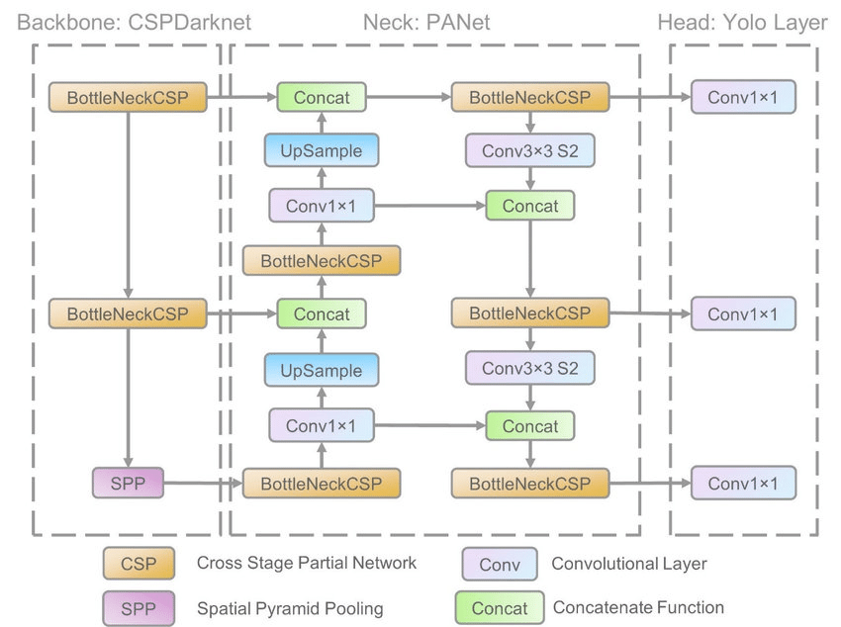
SYSTEM DESIGN
a) Data Labeling: The data set contains images of thegesture. To train data in YOLOv5 the data set needs to havelabels and the annotating bounding box. The value of theannotating box coordinate should be normalized between 0-1.To make the bounding box of each image an online websiteRoboﬂow(www.roboﬂow.com) is used. This website makes iteasy to annotate and make data labels in the desired format.
b) Data Augmentation: The data that we are usingto train our model is quite small. To make the modelmore generalized and avoid over-ﬁtting, data augmentationis a well-proven and common technique. We apply dataaugmentation in the images that are used for training.
C. Model Training ProcessThe approach is to ﬁne-tune the YOLOv5x model which isalready pre-trained on the COCO data set. Transfer learning[20] is used to train on the newly comparatively small dataset. Also, various augmentation processes such as HSV, colorspacing, mosaic, image scaling were applied to augment theinput image. The hyperparameters that are ﬁne-tuned on theCOCO data set are used here such as SGD optimizer, 0.01learning rate, 0.0005 weight decay and then we use 300 epochon batch size 16. The model gives pretty stable and goodaccuracy after 183 epoch. After that the changes are negligible

Slide 9
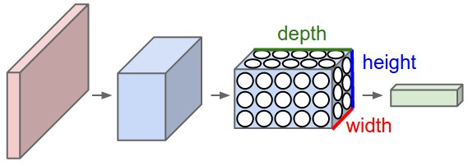
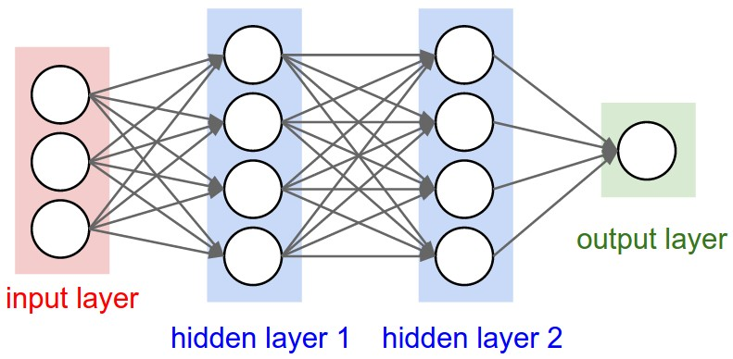
SYSTEM DESIGN
Fig.
Convolutional Neural Networks are very similar to ordinary Neural Networks from the previous chapter: they are made up of neurons that have learnable weights and biases. Each neuron receives some inputs, performs a dot product and optionally follows it with a non-linearity. The whole network still expresses a single differentiable score function: from the raw image pixels on one end to class scores at the other. And they still have a loss function (e.g. SVM/Softmax) on the last (fully-connected) layer and all the tips/tricks we developed for learning regular Neural Networks still apply.
The hidden layer is then followed by a Flatten and Dropout layer to convert the data in 1D and ensure overfitting.

Slide 10
IMPLEMENTATION
TESTING AND LIVE DETECTION
import cv2
import time
video=cv2.VideoCapture(0)
count=0
while True:
ret,frame=video.read()
count=count+1
name='./images/'+'thanks'+'/'+'thanks'+str(count)+'.jpg'
cv2.imwrite(name, frame)
cv2.imshow("Frame",frame)
k=cv2.waitKey(1)
time.sleep(2)
if count>30 or k==ord('q'):
break
video.release()
cv2.destroyAllWindows()

Slide 11
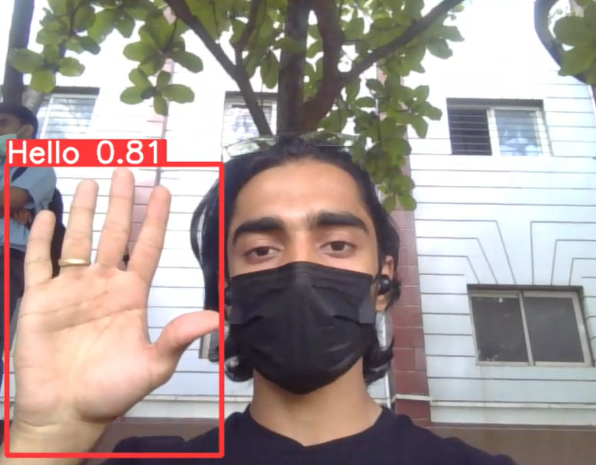
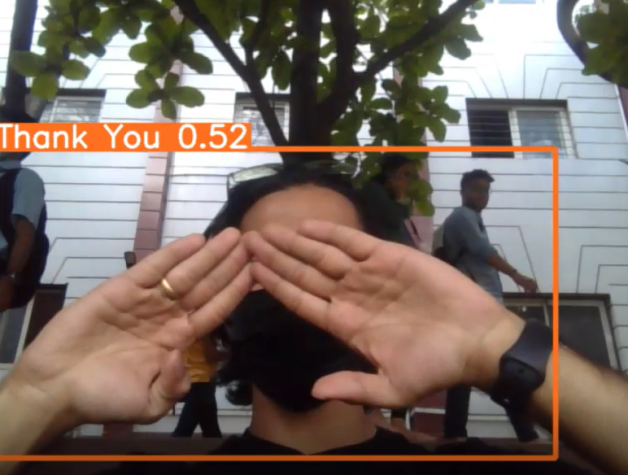
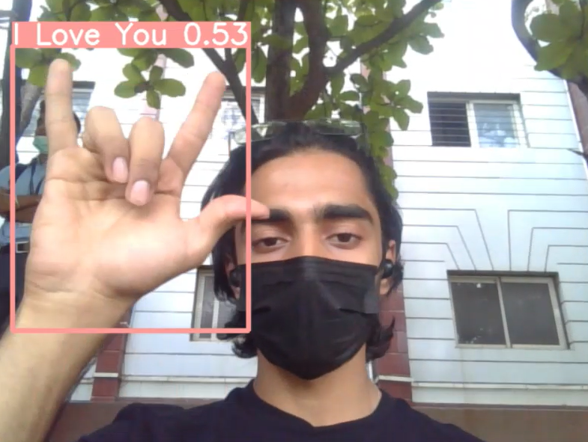
RESULTS

Slide 12
CONCLUSIONS
As is evident nowadays that hand gesture detection is very crucial, given this project was an attempt in creating a simple hand gesture recognition detetctor.
It can ease the process of communication with people who are hearing impaired and profoundly deaf.
In this project, a deep learning model for hand gesture recognition was developed with the help of Convolutional Neural Networks using Python and OpenCV.
The observed model proved to be 80% accurate in the detection of the presence of hand gestures.

Slide 13
LIMITATIONS
Our trained model uses Yolov5s which is very small and simple object detection model which gives less accuracy.
Instead of that we can use Yolov5x object detection model which uses more compute power and provides more accurate results.

Slide 14
FUTURE ENHANCEMENTS
We can integrate this project in an application for ease of use.
More accurate predictions can be made.
Better web cam can be used to capture more results.
More frames and intern provide a better detection results.

Slide 15
REFERENCES
https://github.com/ultralytics/yolov5
https://colab.research.google.com/github/ultralytics/yolov5/blob/master/tutorial.ipynb

Slide 16
Question and Answer

Slide 17
THANK YOU

